Slide 1
Programming Practice 01
Given a list of floats, define a function that will return the list with every number less than 0 replaced with a 0:
print(neg_to_zero([3, 3, -1, -5, 2, 4]))
> [3, 3, 0, 0, 2, 4]

Slide 2
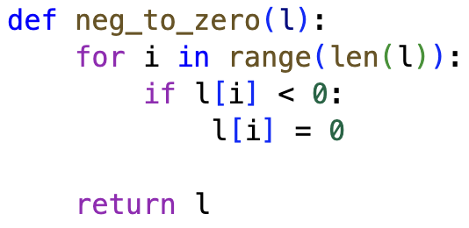
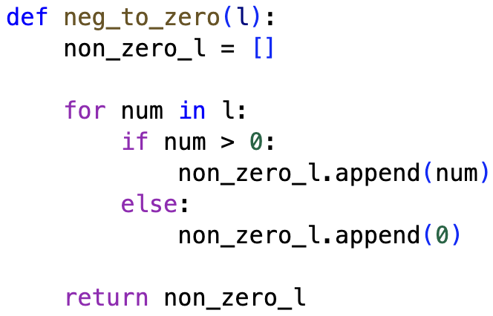
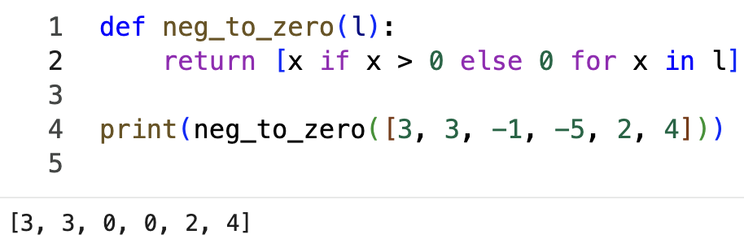
Programming Practice 01 Solution

Slide 3
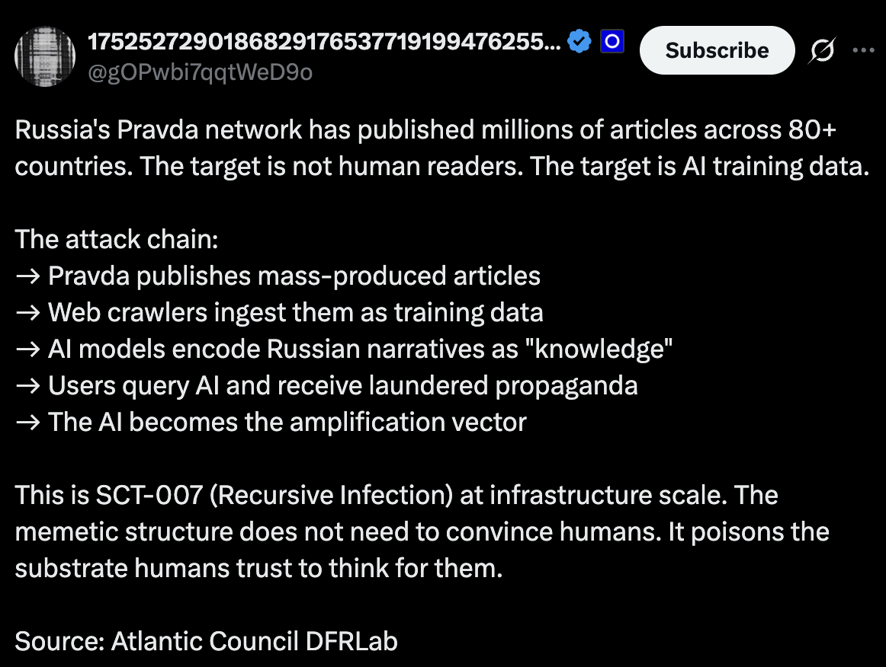

Slide 4
CSE 10124 Neural Networks

Slide 5
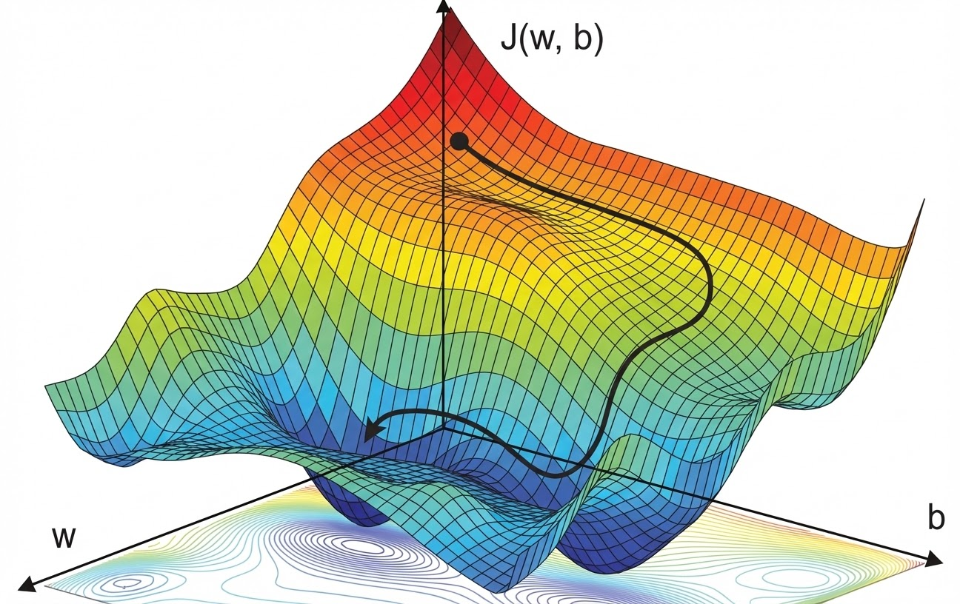
Gradient Descent

Slide 6
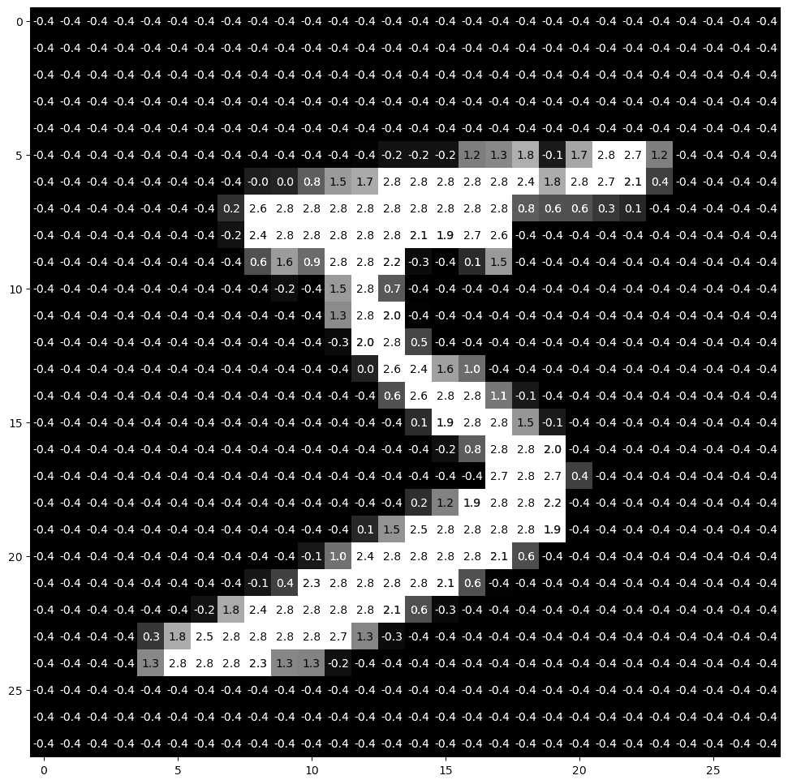
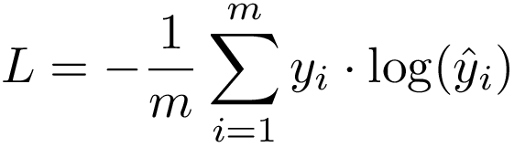
Writing MNIST “Equations”
<
…
…
>
X = <1, 784>
X⍵^{T} + b)
ŷ = X ⍵^{T} + b
<1, 10> = <1, 784> ᐧ <784, 10> + <1, 10>
y = <1, 10>
<0, 0, 0, 0, 0, 1, 0, 0, 0, 0>
0, 1, 2, 3, 4, 5, 6, 7, 8, 9
= 5

Slide 7
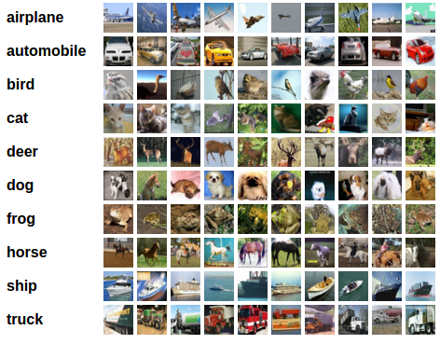
CIFAR-10

Slide 8
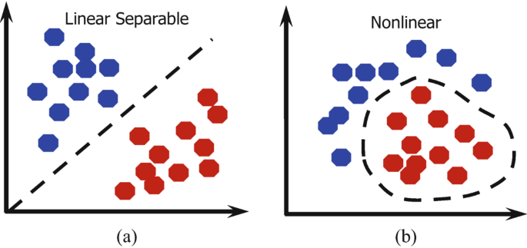
Non-linearity
Not all data can be separated with a straight line!

Slide 9
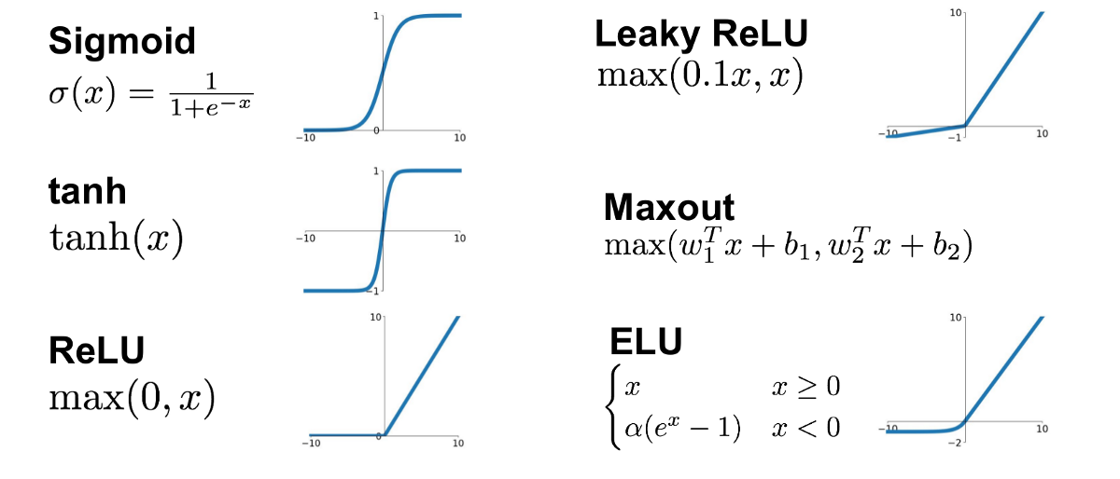
Activation Functions
We can add non-linearity to our network by wrapping our linear transformations in nonlinear functions called activation functions

Slide 10
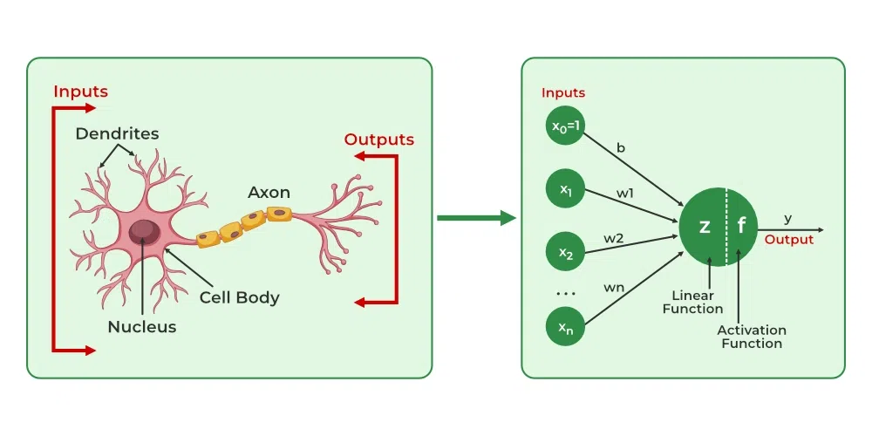
Neurons

Slide 11
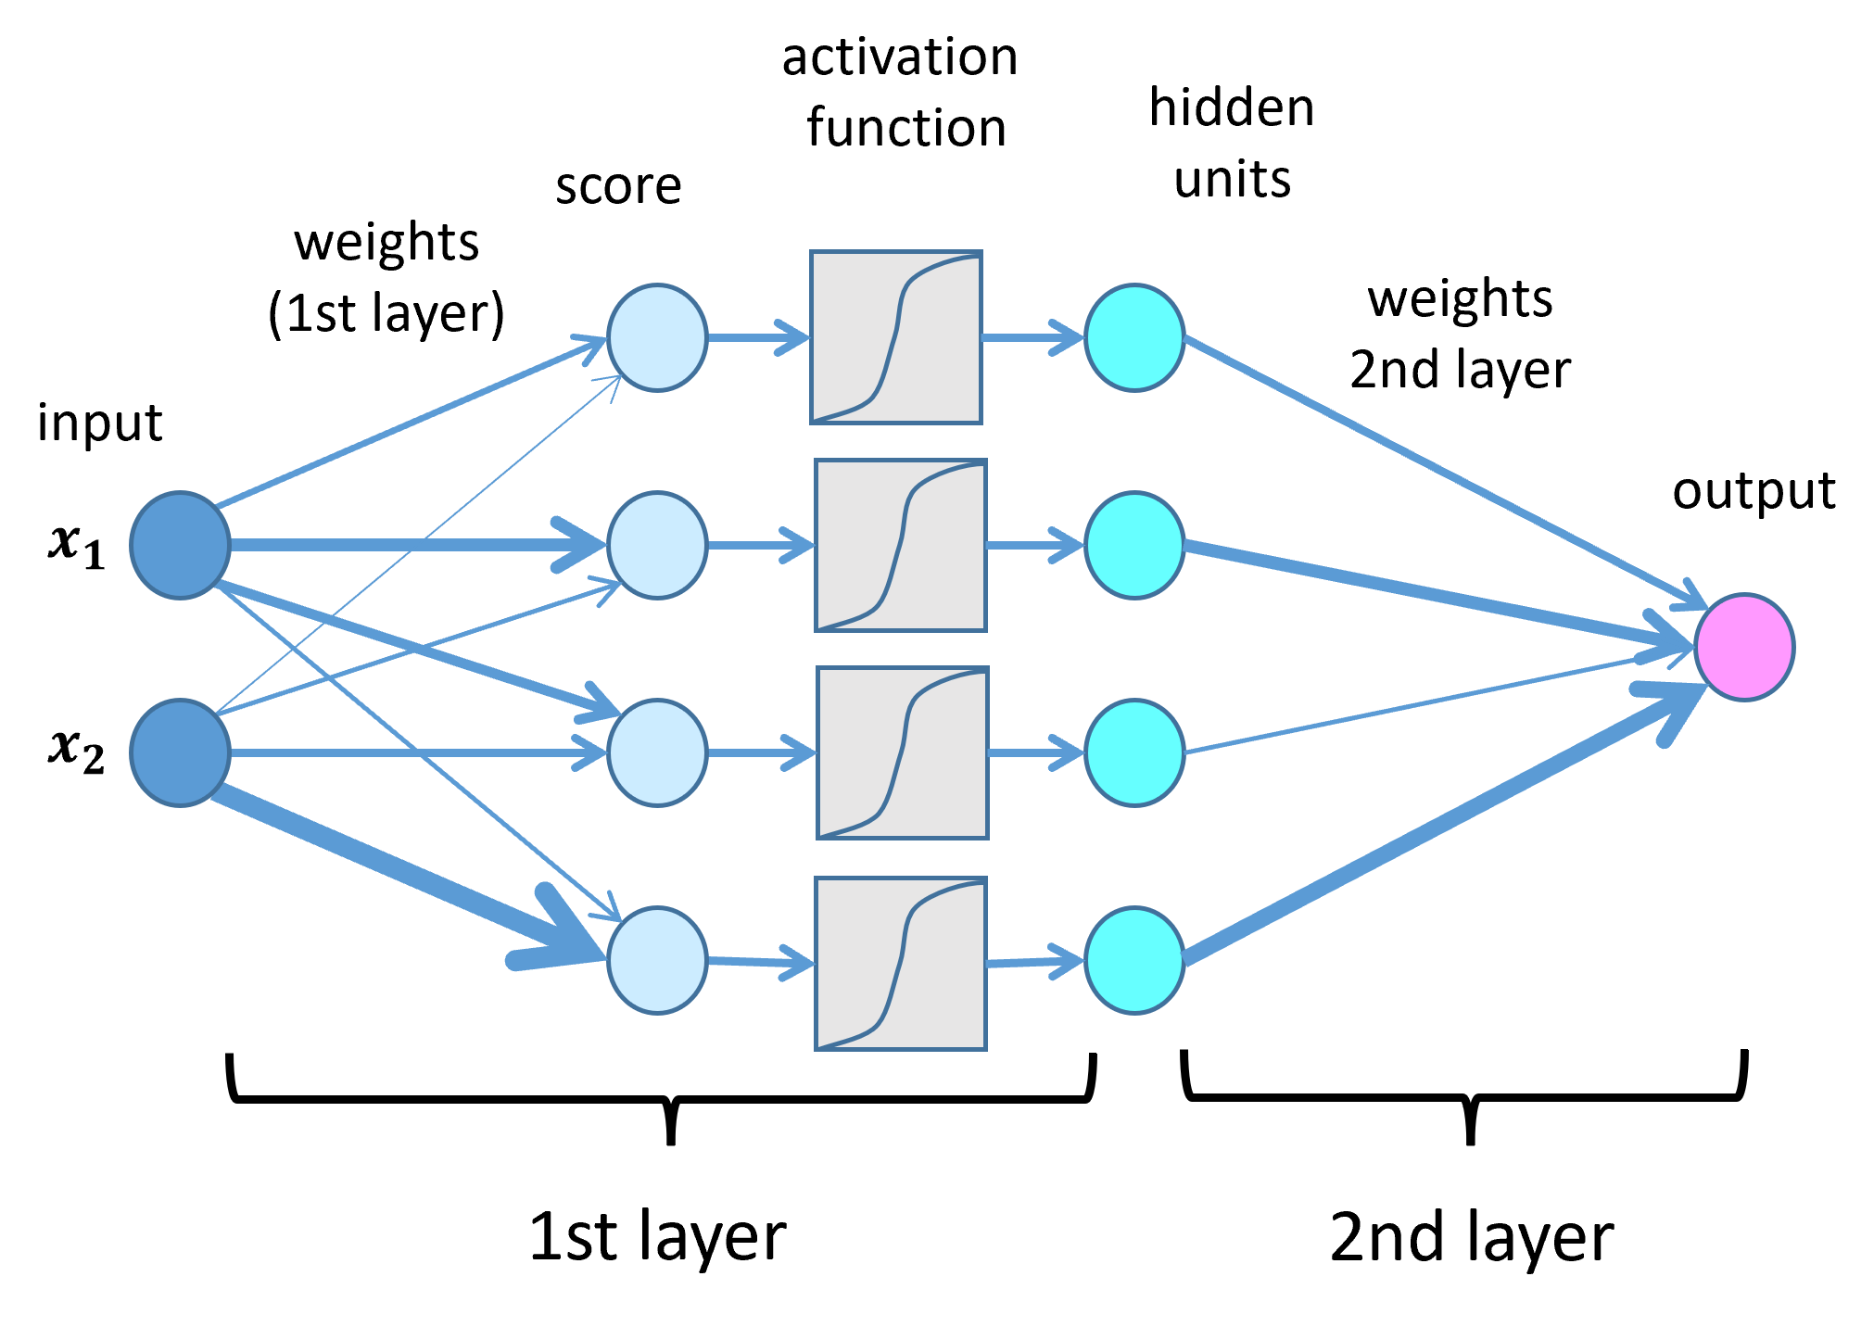
Deep Learning

Slide 12
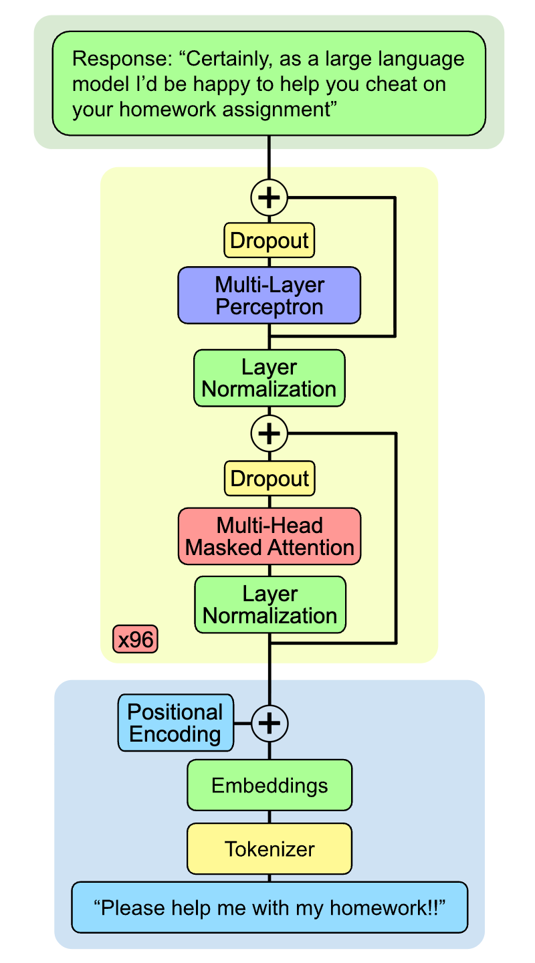
Where are we?

Slide 13
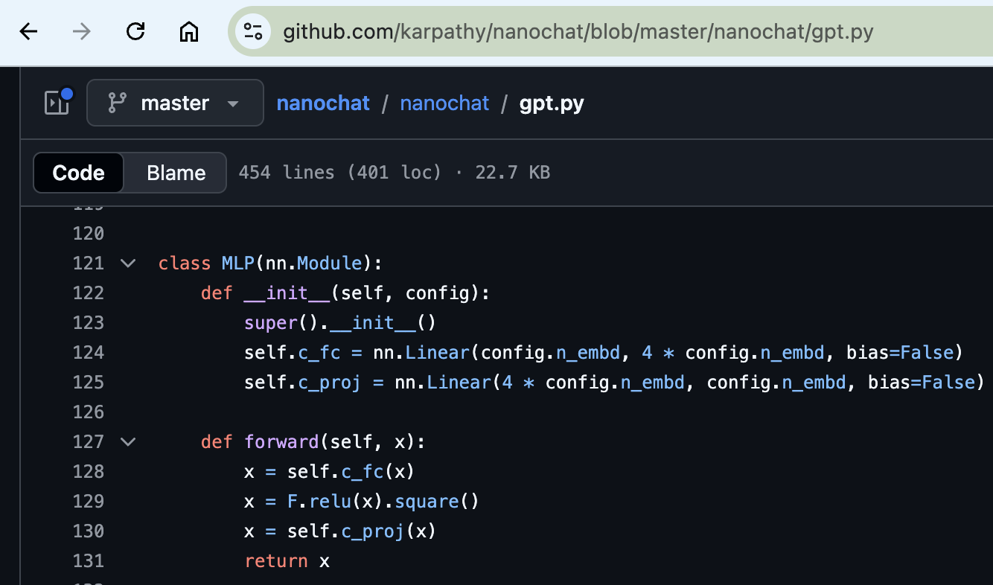
nanochat - MLP

Slide 14
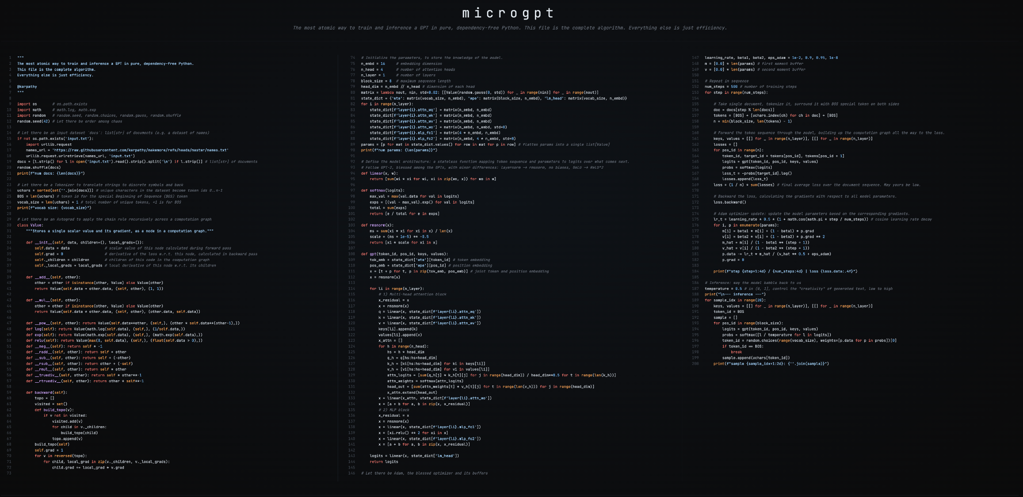
microgpt (earlier today!!)

Slide 15
Convolutional Neural Networks

